Slide 1


Project 4 – Machine Learning
Monash Bootcamp
Deepa Nair, Denise Demirkol, Kevin McConchie,
Kinlay Denning, Jeya Emmanuel, Radhika Alapati

Slide 2
Agenda
Project Motivation
Data Set
Project Objective
Data Cleaning
Data Visualisation
Technologies Used
Data pre-processing / Steps of Processing
Models - Decision Tree, Adaboost, Random Forest, Logistic Regression, KNN, SVC, Tensor Flow - Deep Learning
Project Summary
The APP

Slide 3

Motivation
Telecommunication Technology plays a major role in today’s world as almost everyone uses this technology in one way or the other. Telecom companies are competing in an increasingly fast-paced, complex, global economy. To succeed, they must navigate a world where customer needs are changing rapidly, where a strong omnichannel strategy is mandatory, and where extensive technology investments—most notably 5G—will be required. Customers when given choices will constantly opt for better options hence it is important for Telecom Companies to provide quality service.
Our project is based on analyzing the churn table which contains information on 7,043 customers from a Telecommunications company in California in Q2 2022and using Machine Learning to derive meaningful insights.

Slide 4
Data Set - Telecom Customer Churn Prediction
The Customer Churn table contains information on all 7,043 customers from a Telecommunications company in California in Q2 2022.
Each record represents one customer, and contains details about their demographics, location, tenure, subscription services, status for the quarter (joined, stayed, or churned), and more!
The Zip Code Population table contains complementary information on the estimated populations for the California zip codes in the Customer Churn table Collection Methodology
https://www.mavenanalytics.io/blog/maven-churn-challenge

Slide 5
Project Objective
Finding the % of Churn Customers and customers that keep in with the active services.
Analyzing the data in terms of various features responsible for customer churn
Finding a most suited machine learning model for correct classification of churn and non churn customers
To develop an application to predict whether the customer will churn or not using the explanatory variables

Slide 6
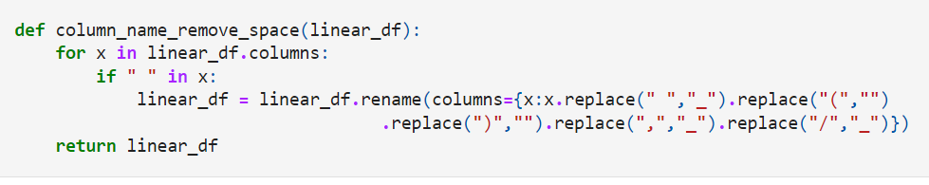
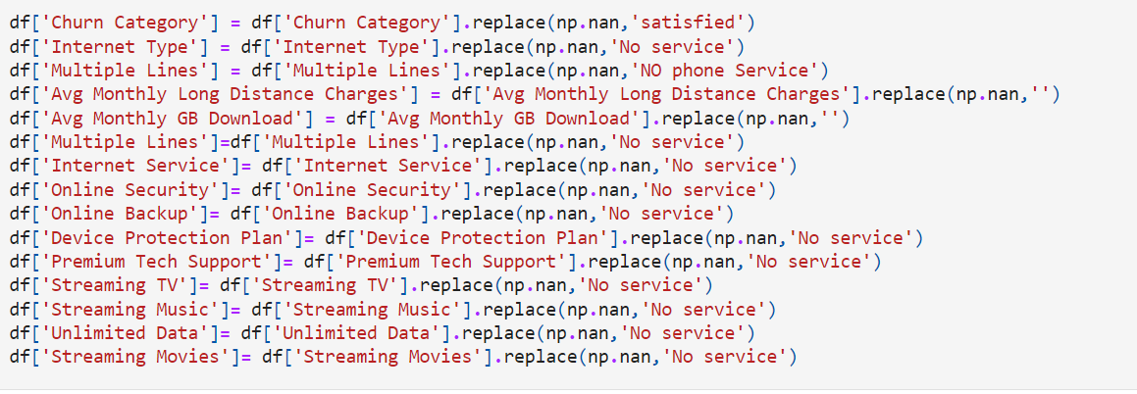
Data Cleaning
We checked the number of rows and columns(features in the dataset)
We removed null values and drop columns that we didn’t require from the data set
We ensured that the format of all the fields match. We had to replace the spaces in some columns
In some cases we replaced null values with meaningful data

Slide 7
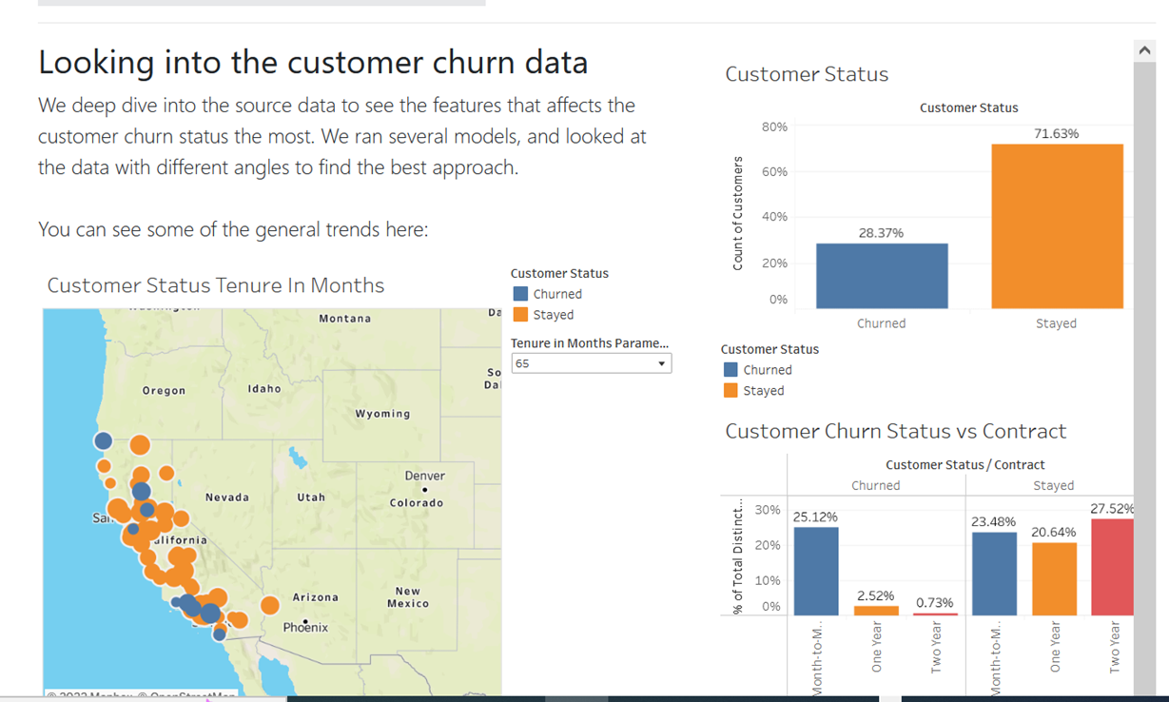

Data Visualisation

Slide 8









Technologies Used

Slide 9
Data Pre-processing – Fulfilling the basic assumptions of modeling
Prediction Outcome Nature - Binary outcome Predicting whether the customer will churn or not.
Supervised Learning is applied as we have a labelled data set.
The Requirements for machine learning models selected based on the prediction outcome
The Response Variable is Binary
There is No Multicollinearity Among Explanatory Variables
The Sample Size is Sufficiently Large (more than 500 data points)
There are No Extreme Outliers

Slide 10
Steps of Processing
Data Imputation
Feature selection is one of the first and important steps while performing any machine learning using heatmaps and box plots. A feature in case of a dataset simply means a column
Pre-process ordinal and nominal categorical variables differently. [label encoder for ordinal and hot encoding for nominal]
Standardization-In Standardization, we transform our values such that the mean of the values is 0 and the standard deviation is 1
Check for Multicollinearity. – we have used VIF

Slide 11
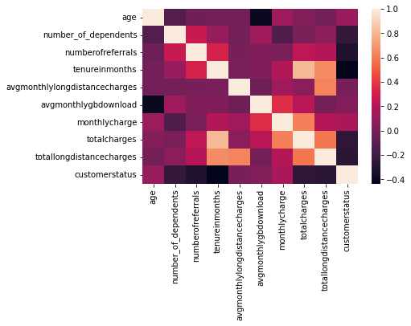
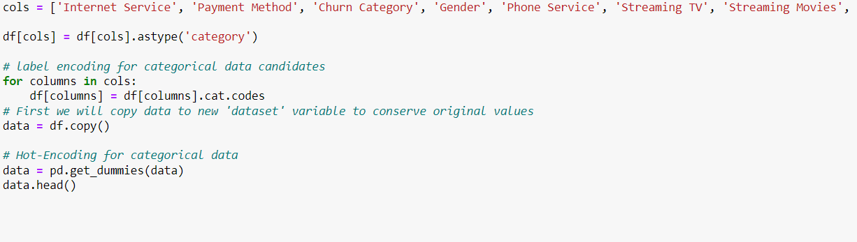
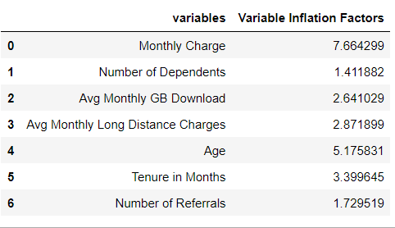
Steps of Processing

Slide 12
Decision Tree & Adaboost
Radhika Alapati

Slide 13


Decision Tree

Slide 14
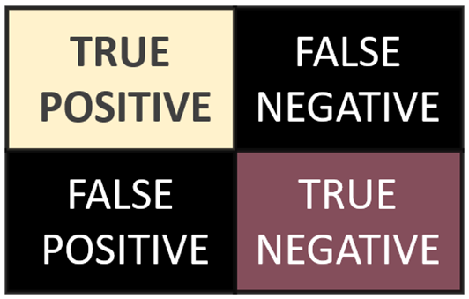
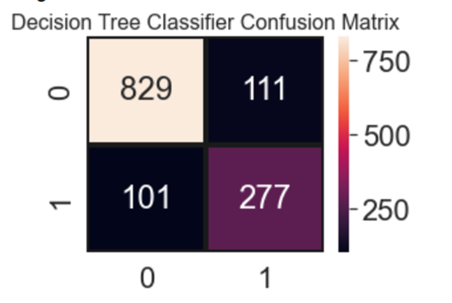
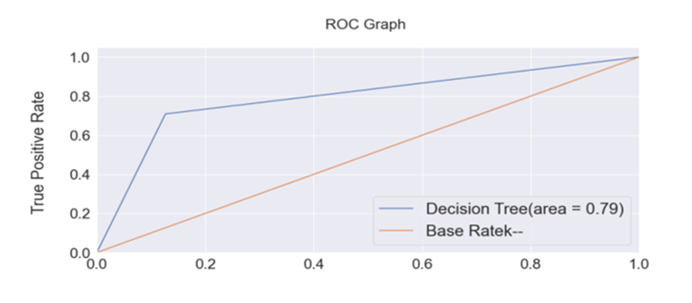

Decision Tree Confusion Matrix

Slide 15
Adaboost Features
AdaBoost is an ensemble learning method (also known as “meta-learning”) which was initially created to increase the efficiency of binary classifiers. AdaBoost uses an iterative approach to learn from the mistakes of weak classifiers, and turn them into strong ones

Slide 16
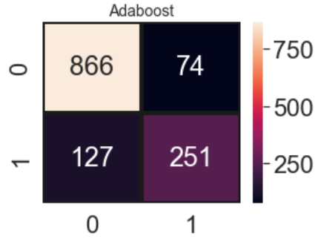
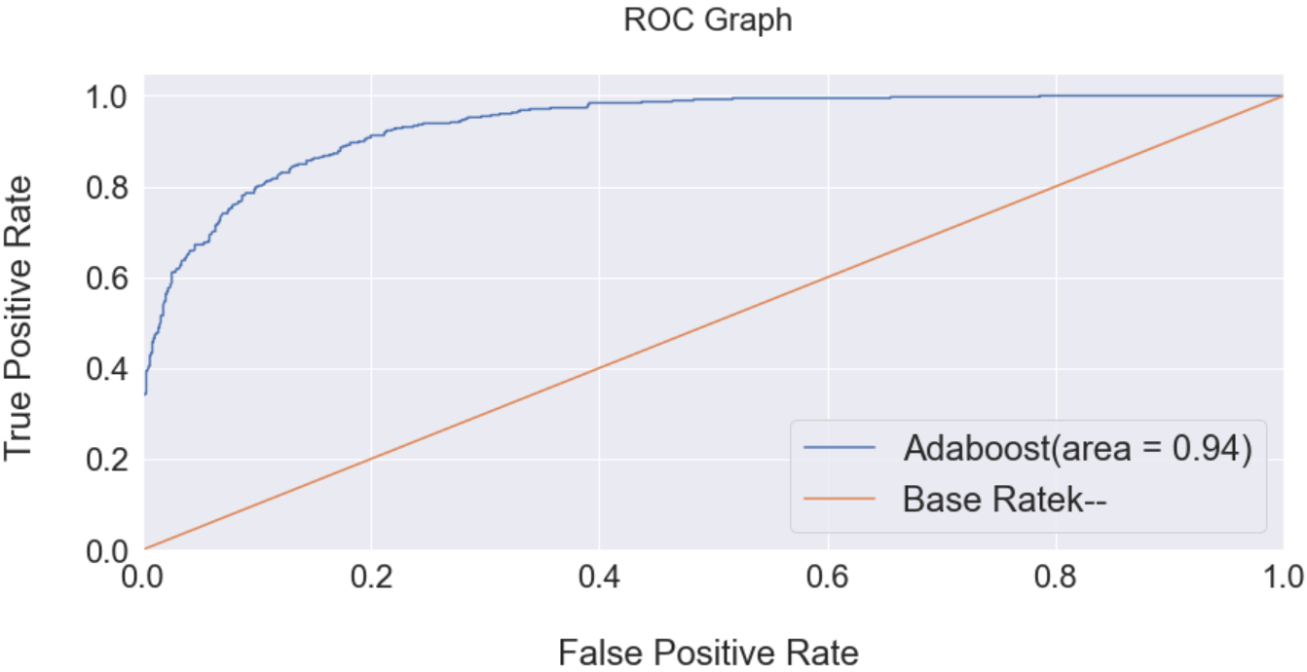
Adaboost Confusion Matrix

Slide 17
Random Forest
Jeya Emmanuel

Slide 18
Random Forest Features
Accuracy of Random forest is generally very high
Efficiency is particularly notable in Large Data sets
Provides an estimate of important variables in classification
Forests generated can be saved and reused
Unlike other models It does not overfit with more features
Estimates missing values

Slide 19
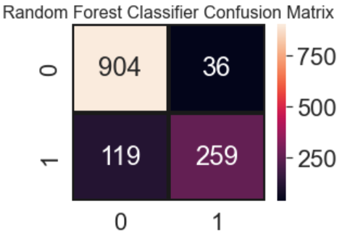

Random Forest - Confusion Matrix

Slide 20
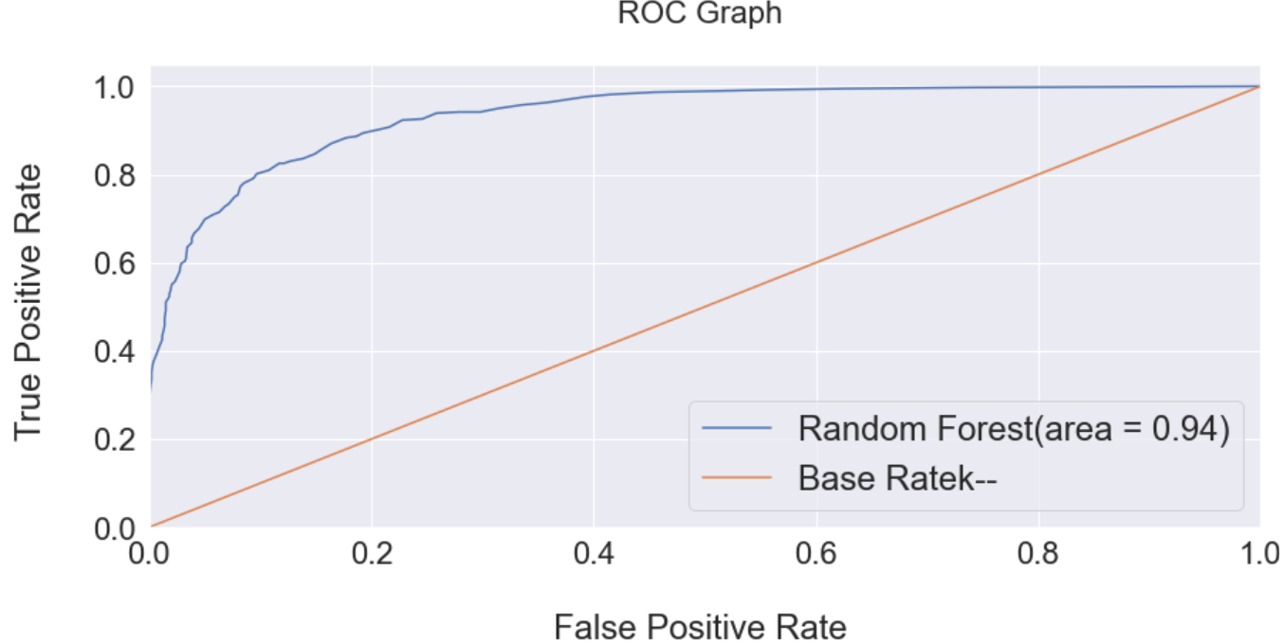
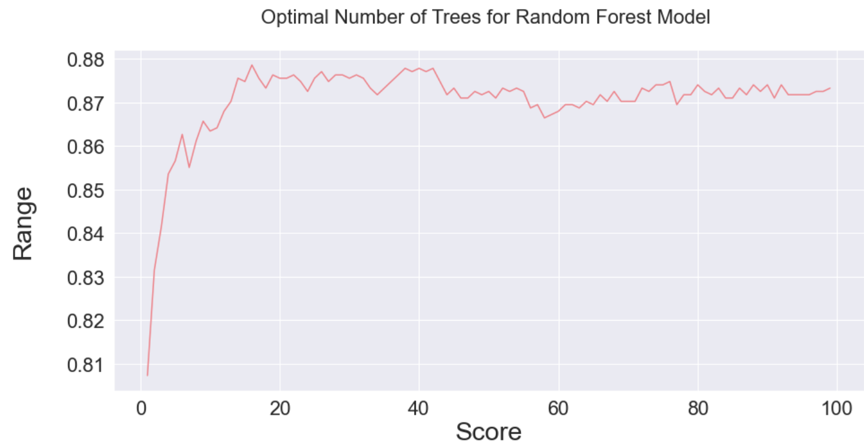
ROC(Receiver Operating Characteristic Curve & Optimal Number of Trees for Random Forest Model
Notes:
An ROC curve (receiver operating characteristic curve) is a graph showing the performance of a classification model at all classification thresholds. This curve plots two parameters:
True Positive Rate
False Positive Rate
An ROC curve plots TPR vs. FPR at different classification thresholds. Lowering the classification threshold classifies more items as positive, thus increasing both False Positives and True Positives

Slide 21
Logistic Regression
Kevin McConchie

Slide 22
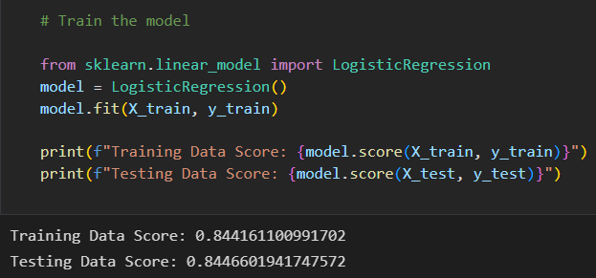
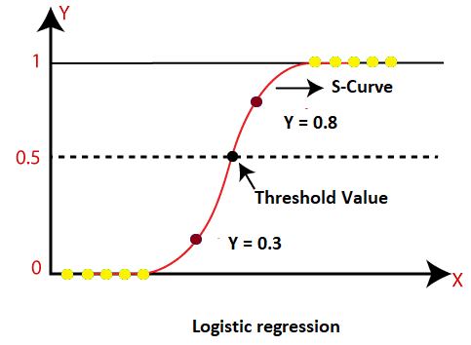
What is Logistic Regression?
Logistic Regression is used when the dependent variable(target) is categorical. For example, To predict whether an email is spam (1) or (0)
It’s a statistical method to predict a discrete output or category within Machine Learning
Since the outcome is a probability, the dependent variable is bounded between 0 and 1

Slide 23
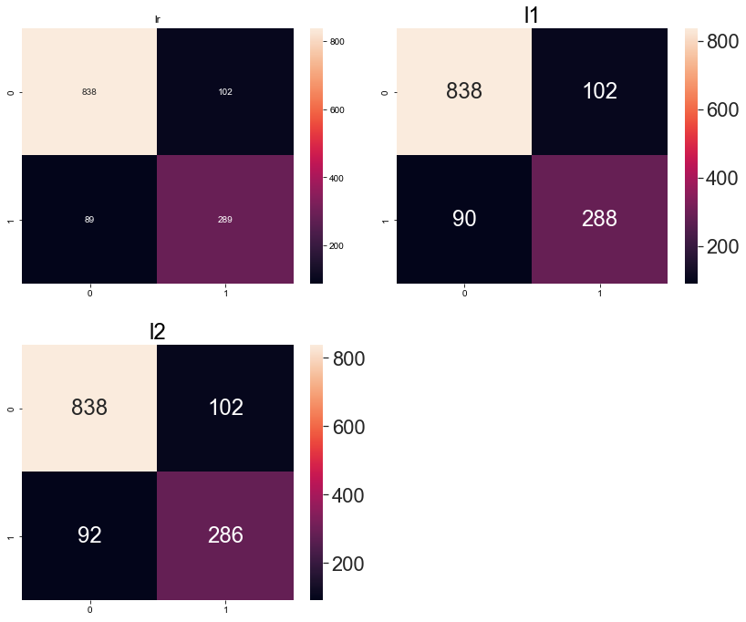

Classifier Confusion Matrix &
L1 vs L2 Regularization
The main intuitive difference between the L1 and L2 regularization is that L1 regularization tries to estimate the median of the data while the L2 regularization tries to estimate the mean of the data to avoid overfitting
To see if we could create a less complex model we turned to L1 and L2 Regularization - It made little difference to the model meaning we had a good fit already

Slide 24
K-Nearest Neighbor(KNN)
Kinlay Denning

Slide 25
How does it work?
KNN belongs to a family of distance-based machine learning algorithms:
· The assumption we make when applying this model type to a classification problem is this: observations that are in close proximity are alike.
· This similarity suggests that a dataset can be divided into discrete categories.
· For each explanatory variable provided to the model, it is trained to calculate the relative distance of an observation in multidimensional space, and based on that distance, predicts which category it belongs to.

Slide 26
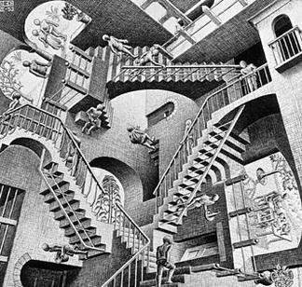
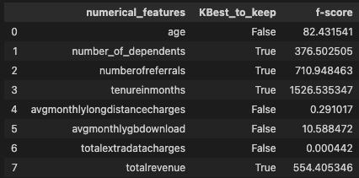
The Problem of Feature Selection
"Two points are close only if they're close in every dimension ... and every extra dimension is another opportunity for each point to be further away from every other point." - Joel Grus, Data Science from Scratch

Slide 27
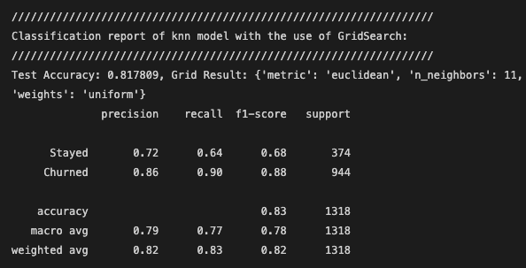
Interpreting the results
GridSearchCV Hyperparameter tuning:
The following optimal hyperparameters were obtained:
The value of K, given by the optimum number of neighbours the algorithm has decide it needs, in order to class each observation.
The recommended weight was a uniform distribution. This means that all points in each neighbourhood have equal influence in predicting the class.

Slide 28

SVC
Denise Demirkol

Slide 29

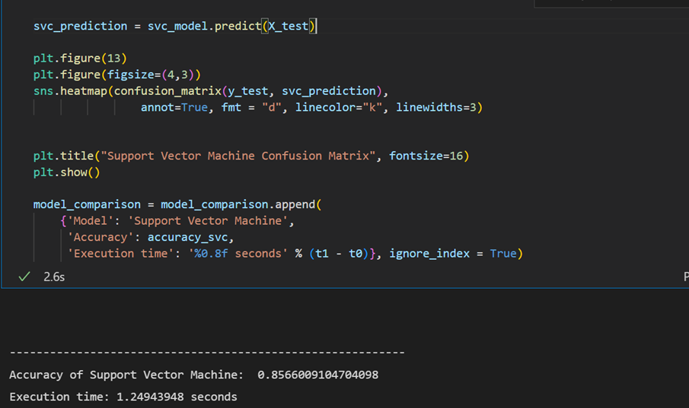
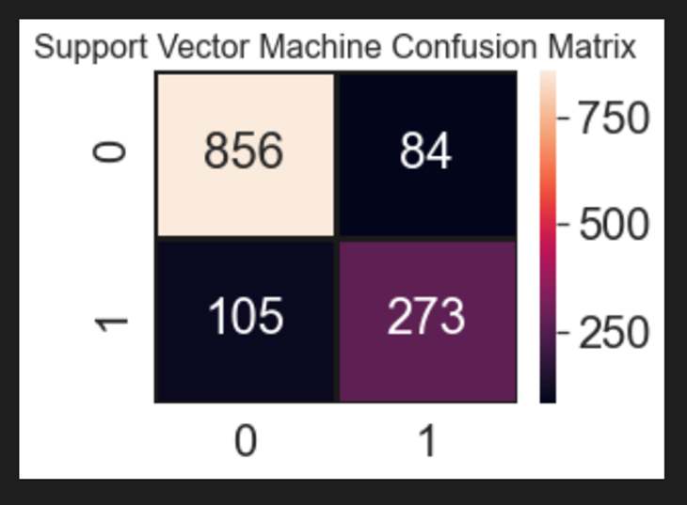

Slide 30
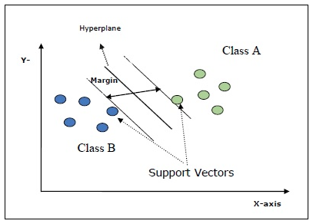
The main goal of SVMs is to divide the datasets into number of classes in order to find a maximum marginal hyperplane (MMH) which can be done in the following two steps −
1- Support Vector Machines will first generate hyperplanes iteratively that separates the classes in the best way.
2- After that it will choose the hyperplane that segregate the classes correctly.
Support Vectors − They may be defined as the datapoints which are closest to the hyperplane. Support vectors help in deciding the separating line.
Hyperplane − The decision plane or space that divides set of objects having different classes.
Margin − The gap between two lines on the closet data points of different classes is called margin.

Slide 31
Tensor Flow (Deep Learning)
Deepa Nair

Slide 32
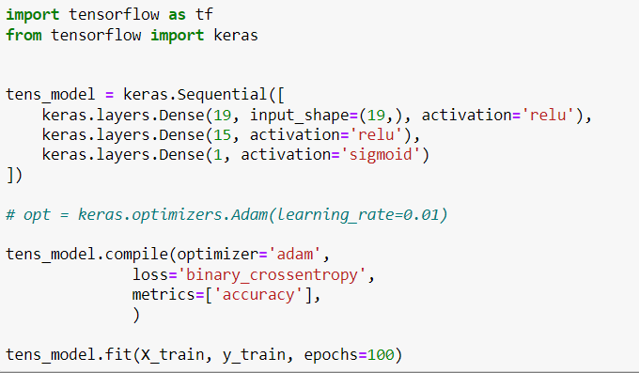
TensorFlow is an open-source library developed by Google primarily for deep learning applications

Slide 33
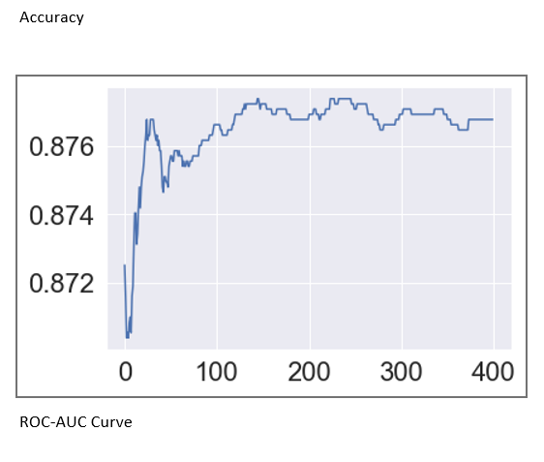
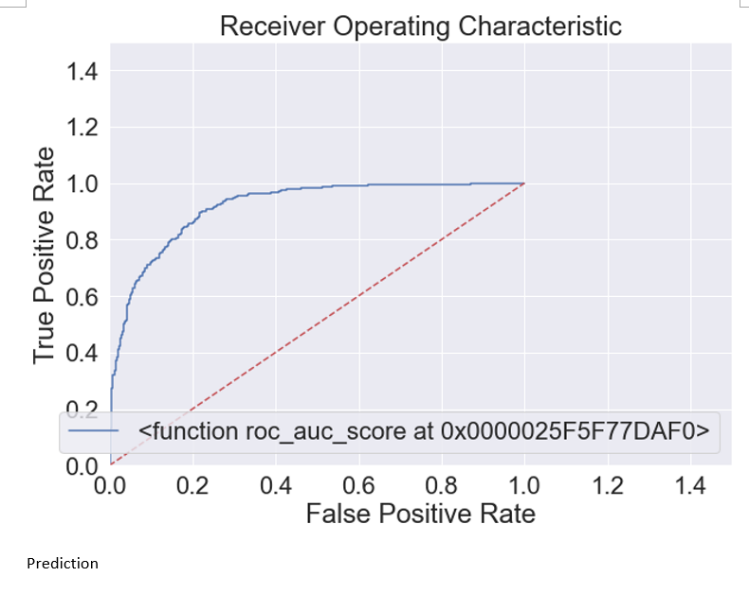
Graphs

Slide 34
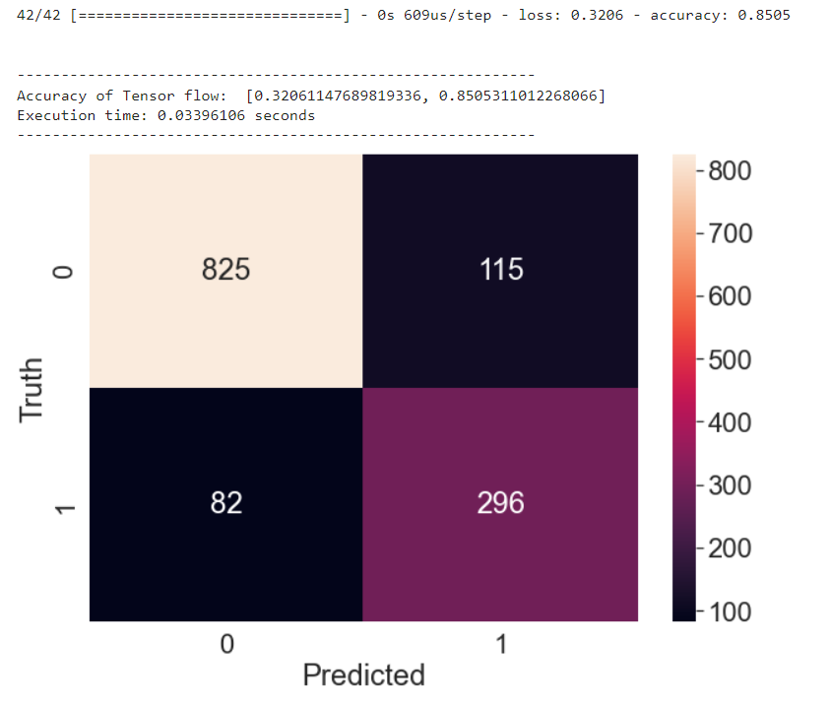
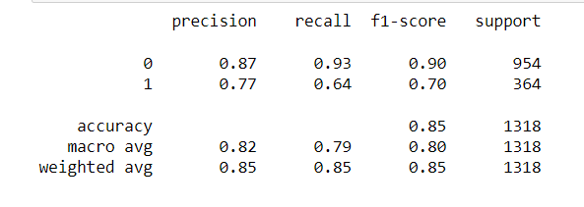
Results

Slide 35
Project Summary

Slide 36
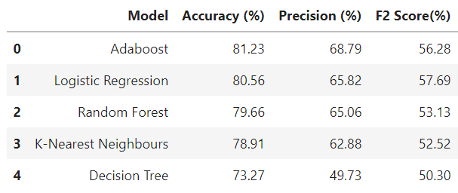
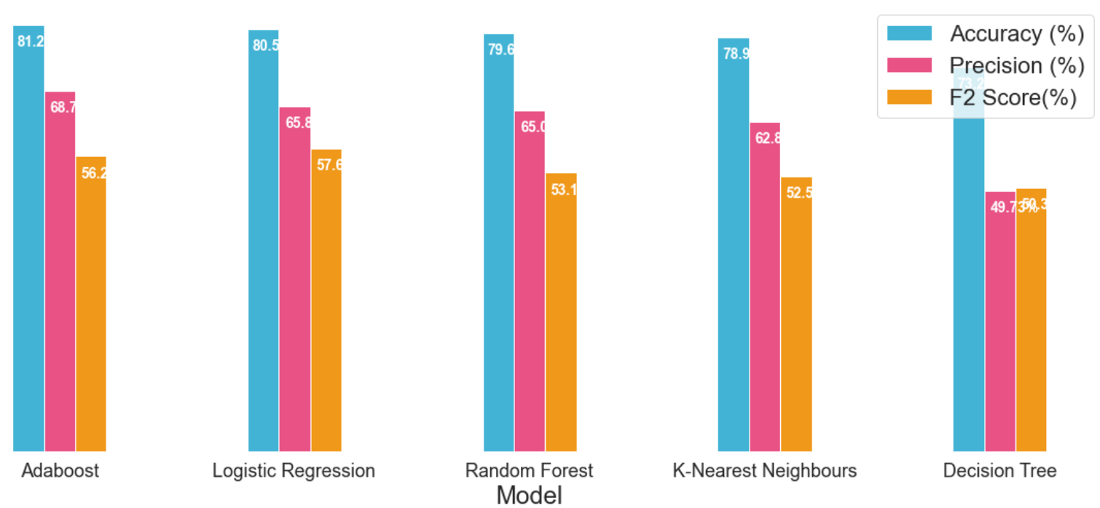
Conclusion
In this project, we have walked through a complete end-to-end machine learning project using the Telecom customer Churn dataset. We started by cleaning the data and analyzing it with visualization. Then, to be able to build a machine learning model, we transformed the categorical data into numeric variables (feature engineering). After transforming the data, we tried 6 different machine learning algorithms (including Deep Learning) using default parameters. Finally, we tuned the hyperparameters of the Adaboost (best performance model) for model optimization, obtaining an accuracy of nearly 81%.

Slide 37
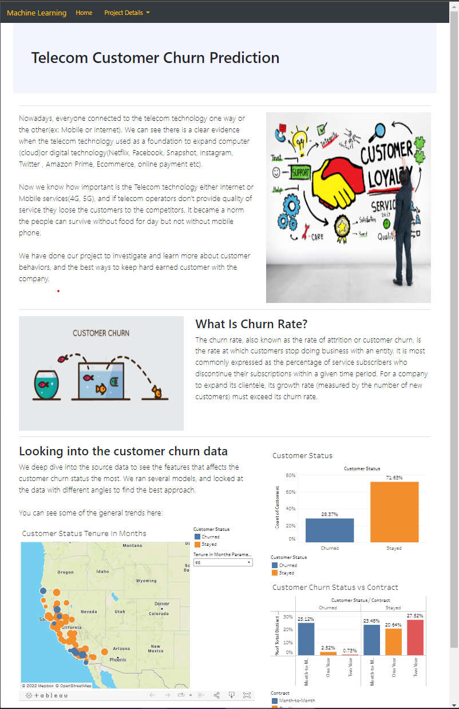
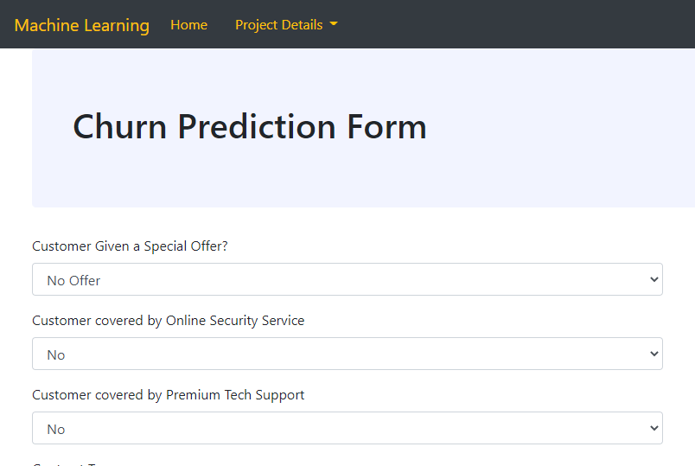
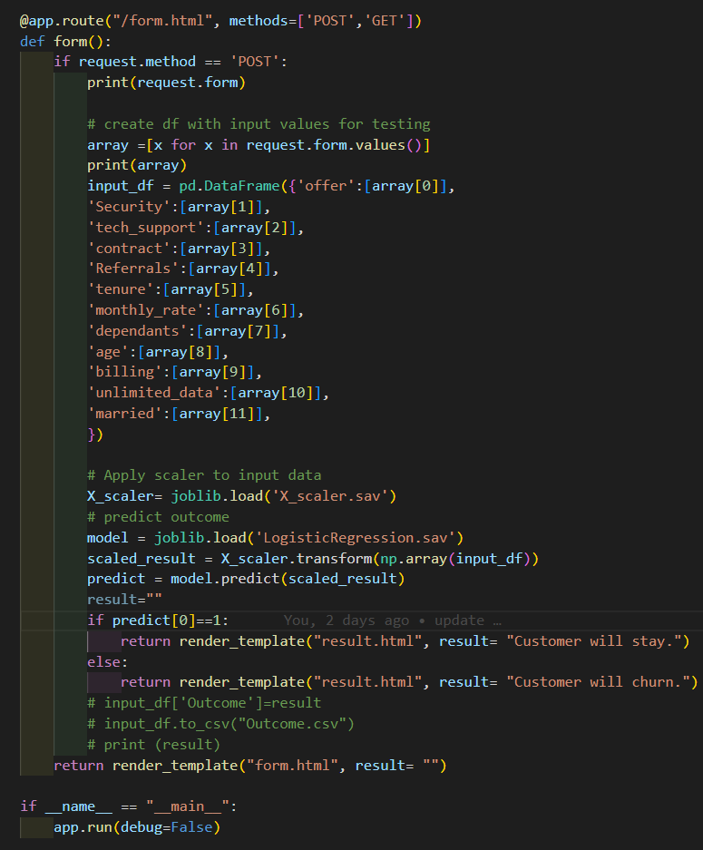
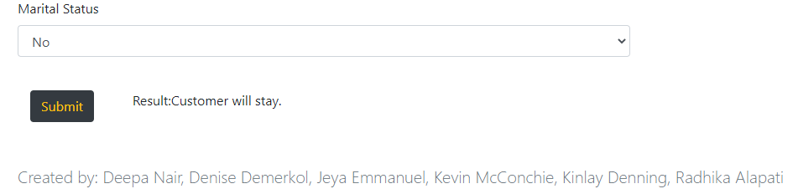
The APP

Slide 38

Questions

